Slide 1
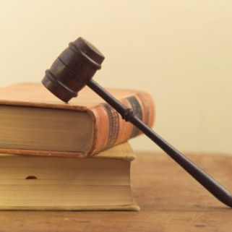

Obligations and Responsibilities
SS.7.C.2.2 Evaluate the obligations citizens have to obey laws, pay taxes, defend the nation, and serve on juries.
The critical role of civic participation!

Slide 2




Bell Ringer
What are some of the chores that you have to do and/or the rules that you have to follow in your daily lives?
Try to think of at least 3 or 4!

Slide 3
How do citizens participate?
Obligations and Responsibilities of Citizens

Slide 4
What does that mean?
Obligation/Duty
Responsibility
An obligation or duty is something you must do because of legal requirement
An example? Obey the law!
A responsibility is something that you are expected to do
An example? Vote!

Slide 5
Fulfilling Our Obligations and Responsibilities
What to we achieve by fulfilling our obligations and responsibilities in our communities?
COMMON GOOD!
The common good is supporting the good of the community as a whole.
Notes:
Explain the common good serve to support the community as a whole by doing the most good for the most amount of people. Common good is promoted by participating in the civic life of our community and fulfilling our obligations.

Slide 6
How Do you Support the Common Good?
Think about ways that we can support the common good in our schools and community. Type one example of this into the chat.

Slide 7
What do you think?
What would be the consequences or outcome on society if citizens did not fulfill their responsibilities?
Notes:
Make sure students consider the importance of civic participation. What if people did not vote? What if people did not volunteer? What if we did not petition the government? What if people didn’t run for public office?
We would experience many of the same people running the government with no new ideas and lack of representation of the people.

Slide 8
Assignment: Part 1
Use pg. 124-127 (this PDF is posted on Teams) to complete the charts in today’s Word doc assignment.
Complete the chart asking you to list the different obligations and responsibilities of citizenship and what they mean.

Slide 9
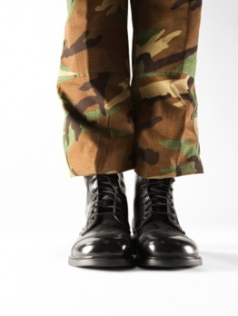

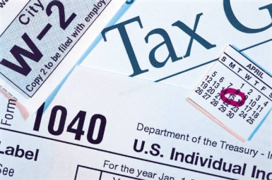
Examples of Obligations/Duties
Obey the law
Attend school
Pay taxes
Defend the nation
Register for selective service: draft; required military service during times of need
Serve on juries
Notes:
Ask students who is required to follow the law. Answer: EVERYONE. There is a concept called “rule of law” that means everyone must follow the law and no one is above the law.
Go on to explain that because of laws, we are required to pay taxes, defend the nation in times of need, and serve on juries.

Slide 10

Examples of a civic responsibility:
Voting
Being informed
Taking part in government
Helping your community
Respecting and protecting the rights of others
Notes:
Tell students these are just some of the responsibilities they have in their communities. Other responsibilities can include: volunteering, staying informed, joining civic organizations, and more.

Slide 11
Test your knowledge…
Read the situation on the slide.
If you think it is a responsibility, you will go to the right side of the room.
If you think it is an obligation, go to the left side of the room.
Obligation
Responsibility

Slide 12
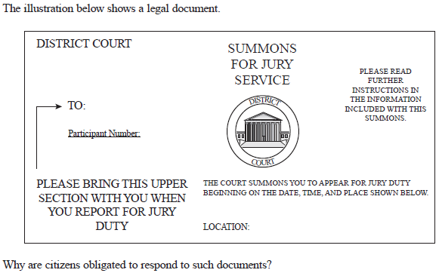
Scenario 1
Mark receives a summons for jury duty. He serves on a jury for two weeks listening to testimony about a robbery that took place and determining the verdict for the case along with his fellow jurors.
Is Mark’s service on a jury a responsibility or an obligation?

Slide 13
Is Mark’s service on a jury a responsibility or an obligation?
Obligation!
Florida law states that any person who is summoned to attend as a juror in any court and who fails to attend without any sufficient excuse shall pay a fine not to exceed $100.
Obligation
Responsibility
Notes:
Jury duty serves a critical function in our society by protecting the constitutional right to trial by jury. Juries are necessary for protecting the rights of those accused of crimes and providing an unbiased verdict in criminal and civil cases.
Florida law (Section 40.23 Florida Statues) states that any person who is duly summoned to attend as a juror in any court and who fails to attend without any sufficient excuse shall pay a fine not to exceed $100, which fine shall be imposed by the court to which the juror was summoned, and, in addition, such failure may be considered a contempt of court.

Slide 14
Scenario 2
On his 18th birthday, Marshall went online and registered for the selective service. This means that in a crisis requiring a draft, men would be called in sequence determined by random lottery number and year of birth.
Is Marshall’s registering the selective service a responsibility or an obligation?

Slide 15
Is Marshall’s registering for the selective service a responsibility or an obligation?
Obligation!
The Military Selective Service Act states that “it is the duty of every male citizen of the United States, and every other male person residing in the United States, who, on the day or days fixed for the first or any subsequent registration, is between the ages of eighteen and twenty-six, to present himself for and submit to registration.”
Obligation
Responsibility
Notes:
From the Military Selective Service Act: Except as otherwise provided in this title (sections 451 to 471a of this Appendix) it shall be the duty of every male citizen of the United States, and every other male person residing in the United States, who, on the day or days fixed for the first or any subsequent registration, is between the ages of eighteen and twenty-six, to present himself for and submit to registration at such time or times and place or places, and in such manner, as shall be determined by proclamation of the
President and by rules and regulations prescribed hereunder.

Slide 16
Scenario 3
Shauna did not like a policy that was recently passed by the state legislature. She decided to create a petition supported by members of her community and included a copy of the petition in a letter to her Representative.
Is petitioning the government a responsibility or an obligation?

Slide 17
Is petitioning the government a responsibility or an obligation?
Responsibility!
Why is petitioning the government an important civic responsibility?
Obligation
Responsibility

Slide 18
Scenario 4
Tax returns are due by midnight April 15th, so long as April 15th is not a weekend. John forgot to complete a tax return and thought it really was not a big deal – he could just wait until next year.
Is the filing of a federal tax return a responsibility or an obligation?

Slide 19
Is the filing of a federal tax return a responsibility or an obligation?
Obligation!
Federal law requires people to pay taxes.
Obligation
Responsibility
Notes:
From the IRS Internal Revenue Service (IRS) Internal Revenue Code:
TITLE 26 > Subtitle A > CHAPTER 1 > Subchapter A > PART I > § 1. Tax imposed
CLICK HERE to see all those who are subject to income tax in the United States.

Slide 20
Scenario 5
Sarah attends her city commission meetings each month so she can be informed about the issues impacting her community.
Is attending civic meetings a responsibility or an obligation?

Slide 21
Is attending civic meetings a responsibility or an obligation?
Responsibility!
Why is attending civic meetings an important part of civic participation?
Obligation
Responsibility
Notes:
By attending civic meetings, citizens can be informed about the events, laws, and issues that are present in their communities. Being an informed citizen is critical to a functioning society.

Slide 22

Scenario 6
Mariselle wakes up at 5:00am to go to the polls for the national elections so she can vote before she has to go to work.
Is voting in an election a responsibility or an obligation?

Slide 23
Is voting in an election a responsibility or an obligation?
Responsibility!
Why is voting an important form of civic participation?
Obligation
Responsibility

Slide 24
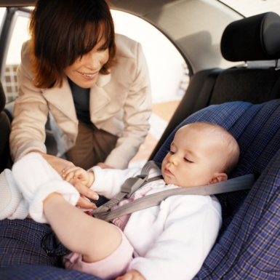
Scenario 7
Jackie is going to the grocery store and puts her 2 year old in a car seat in the back seat of the car.
Is using a car seat for a child a responsibility or an obligation?

Slide 25
Is using a car seat for a child a responsibility or an obligation?
Obligation!
Florida law requires…children through age 3 must be secured in a separate carrier (child safety seat) or in a vehicle manufacturer's integrated child safety seat…Infants must ride rear-facing until they are at least one year old and weigh 20 pounds
Obligation
Responsibility
Notes:
Stress this example as why it is important to follow laws. Laws are created to protect the public and ensure the safety of all.
316.613 Child restraint requirements.— Florida law requires…children through age 3 must be secured in a separate carrier (child safety seat) or in a vehicle manufacturer's integrated child safety seat…Infants must ride rear-facing until they are at least one year old and weigh 20 pounds or more. Rear-facing, the infant should be semi-upright at an angle or no more than 45 degrees. A forward-facing older child should ride sitting upright.
Violation of the child restraint law carries a fine of $60 and 3 points on the driving record.

Slide 26
Scenario 8
Juan doesn’t think his neighborhood association is running efficiently. He decides to run for president of the association in order to correct problems in his neighborhood.
Is running for an office in civic organization a responsibility or an obligation?

Slide 27
Is running for an office in civic organization a responsibility or an obligation?
Responsibility!
Why is running for office an important part of civic participation?
Obligation
Responsibility
Notes:
Running for office is one of the most direct forms of civic participation. Citizens can serve in different levels of government by representing the people from their communities and being their direct voice in government.

Slide 28
Civic Participation
Why is civic participation, both required and voluntary, so important?
In society?
In government?
In the political process?
Notes:
Society: Civic participation is critical for a thriving society. When we participate, we promote the common good by helping others, being engaged and educated, respecting the law, respecting others, defending our nation, supporting the government, and bringing concerns about government of community to the forefront.
Government: We are a government of the people, for the people, and by the people. Without our participation, government does not work properly. We are able to serve on juries, vote, and petition the government – all things that keep the government accountable and rights that we can exercise as citizens.
Political process: We live in a nation where we can participate in government. By voting, being informed, running for office, and petitioning the government, we are able to have our voice heard and make a difference in our communities.

Slide 29
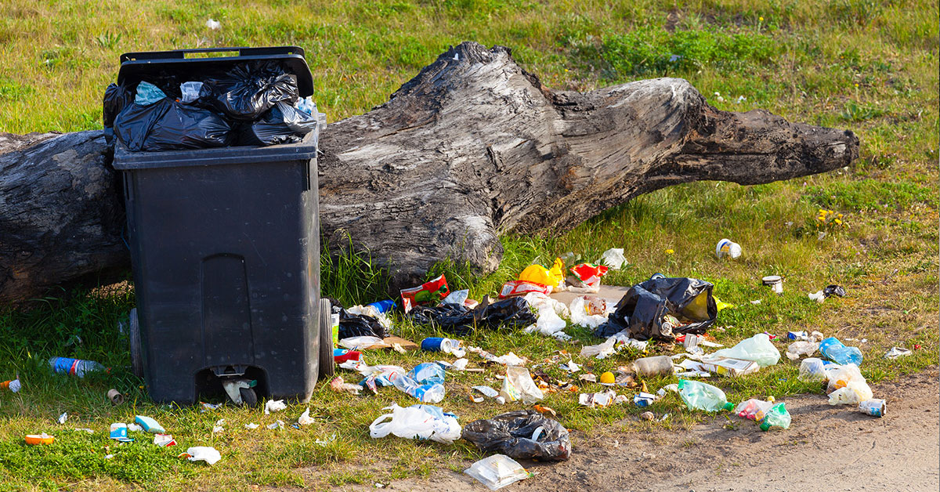
Taking Action
What are some problems that you can think of in our community or society?
Type them into
the chat.

Slide 30
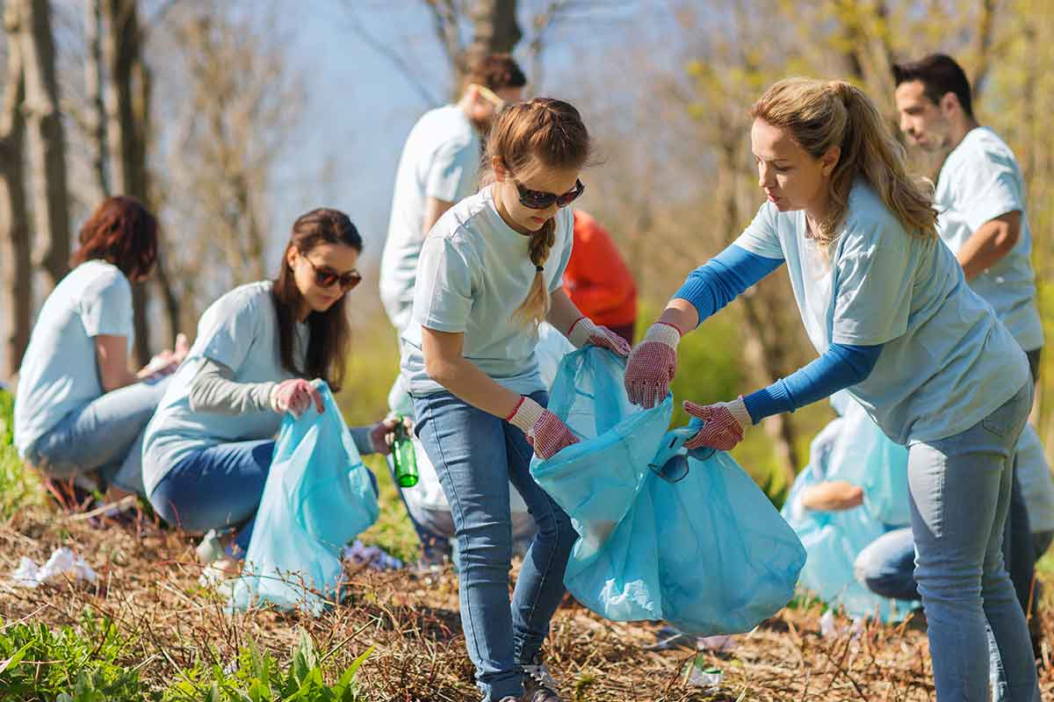
Taking Action
What are some things that you could do to help solve these problems in our communities and society?
Type your ideas
Into the chat.

Slide 31
Civic Participation
Go to our assignment for the day (the Word doc that you have been working on).
Pick one problem that exists in our community or society. How might we help to make this problem better?
Pick at least one obligation and one responsibility of citizenship that could help to tackle this issue. How would these actions demonstrate good citizenship? Be specific.

Slide 32

Check for Understanding
Notes:
These questions are from the Florida Department of Education’s Item Specification Book for the Civics End-of-Course Exam. The response to this question refers to the “right to be tried by one’s peers” which does not appear in the United States Constitution. Had we written the responses, it would read “to protect the constitutional right to trial by impartial jury”.

